Slide 1
Devory OS
中文 (中国)
English (US)

Slide 2
Set up already?
LOG IN
New to Devory?
SET UP YOUR DEVICE

Slide 3
已经安装完成?
登录
尚未安装迪沃系统?
初始化您的设备

Slide 4

Select a dummy disk to install on:
SYSTEM (C:)
19
456 GB FREE
Devory Setup
SKIP THIS STEP

Slide 5
SYSTEM (C:) OVERVIEW
19 GB
456 GB FREE
Devory will create a folder in SYSTEM (C:) named Devory, you will able to find all of the system files
in this folder, total use 1.75GB (1924145348608 Bytes).
CONTINUE WITH THIS DISK
SELECT ANOTHER DISK
Devory Setup

Slide 6
WARNING!
Only Disk (C:) is available on for dummy!
CONTINUE WITH DISK (C:)
Devory Setup

Slide 7
Devory Setup
SELECT YOUR THEME
SKIP THIS STEP
Devory Default

Slide 8
#262626
#EAEAEA
#575DEF
#5DA1D2
Cosmic Black
Prism White
Mirror Purple
Pine Green
Devory Default – Default font for all languages:
Source Hans Pro
Test Print: Abcdefg1234567890!@_#($%^&*)’
Continue with this theme
DEVORY DEFAULT
Devory Setup

Slide 9

Devory Setup
You are nearly all done. We are setting up Devory for you.
Welcome to Devory.
A fast and clean system.
Now you are all set.
Devory User
Log In

Slide 10
选择一个虚拟磁盘进行安装:
SYSTEM (C:)
19
456 GB 可用
迪沃系统安装
跳过该步骤

Slide 11
SYSTEM (C:) 概述
19 GB
456 GB 可用
迪沃系统将在虚拟硬盘 SYSTEM (C:) 内创建一个名为Devory的文件夹, 你可以在该文件夹内查看所有系统文件，
总占用1.75GB (1924145348608 Bytes)的空间。
继续使用该磁盘进行安装
选择另一个磁盘
迪沃系统安装

Slide 12
警告!
只有 SYSTEM (C:) 虚拟磁盘可用！
继续使用磁盘 (C:) 进行安装
迪沃系统安装

Slide 13
迪沃系统安装
选择主题
跳过该步骤
迪沃默认

Slide 14
#262626
#EAEAEA
#575DEF
#5DA1D2
幻夜黑
陶瓷白
霓影紫
仙踪绿
迪沃默认 - 所有语言默认字体:
思源黑体
测试打印: Abcdefg1234567890!@_#($%^&*)’
使用该主题并继续
迪沃默认
迪沃系统安装

Slide 15
迪沃系统安装
你即将完成安装。正在为您安装系统文件，请稍等...
欢迎来到迪沃系统。
一个简洁和快速的系统。
迪沃用户
现在你已经全部完成。
登录

Slide 16
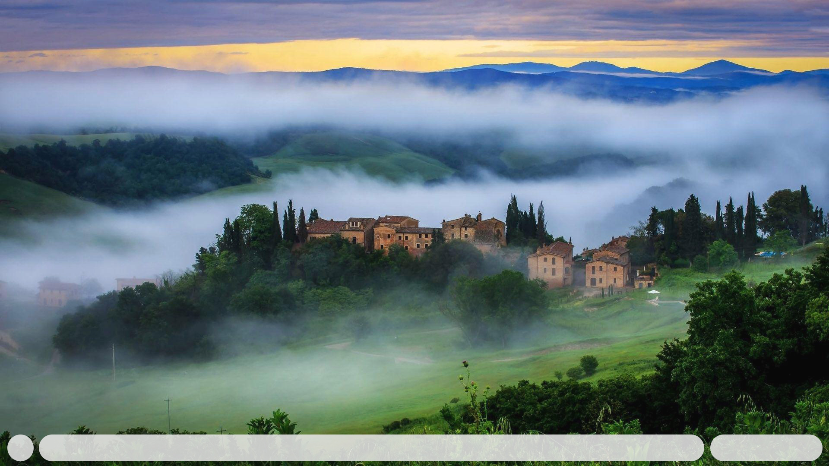


中 拼
09:41
20/09/13
Notes:
Light chn img001

Slide 17
ENG
09:41
13/09/20
Notes:
Light eng img001

Slide 18
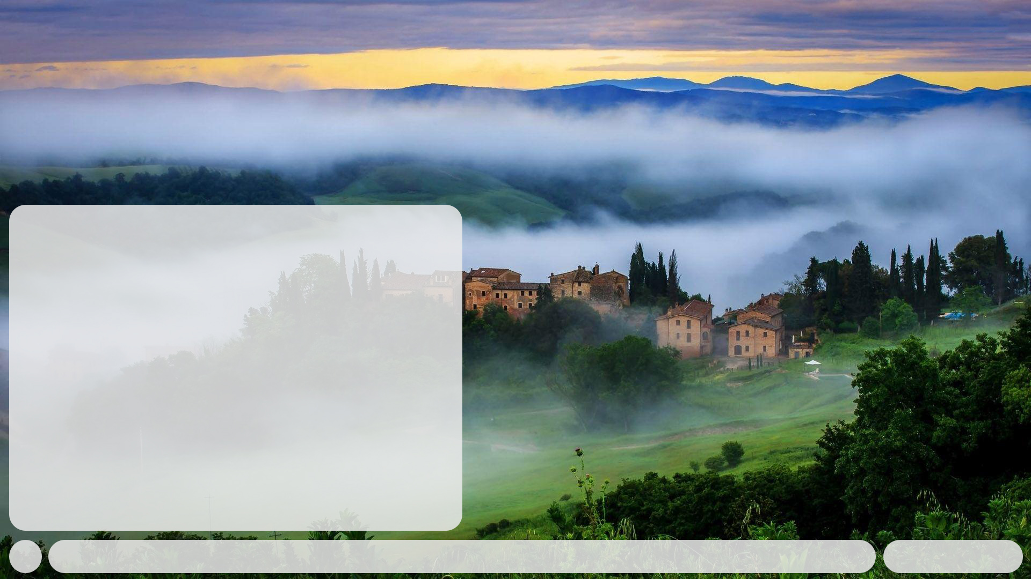







Design & Editing
+
ENG
09:41
13/09/20
Notes:
Light eng img001

Slide 19
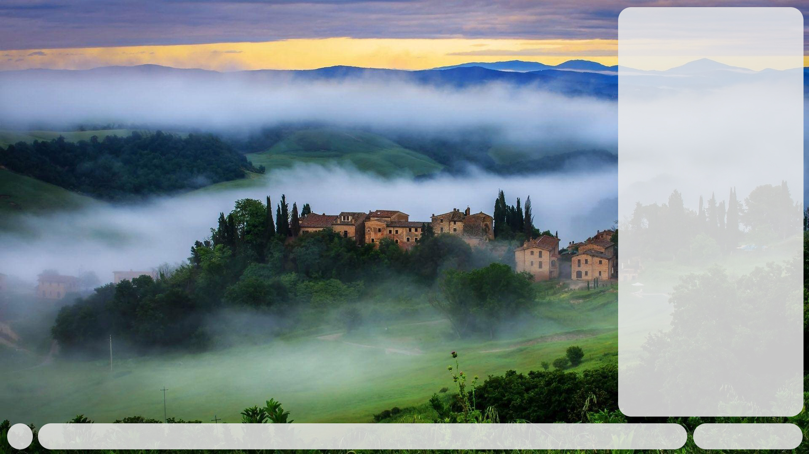

SETTINGS
ENG
09:41
13/09/20
Notes:
Light eng img001

Slide 20
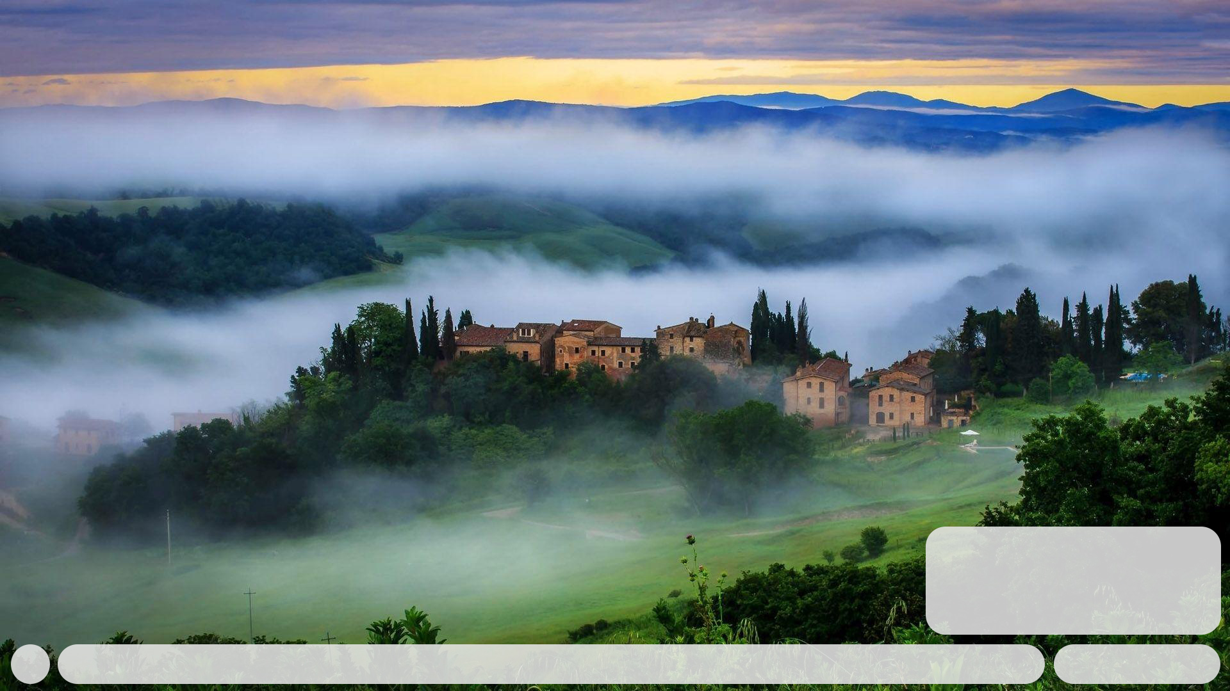

09:41 AEST
Clayton, Melbourne, Australia
13 Sep 2020
Rain
ENG
09:41
13/09/20
Notes:
Light eng img001

Slide 21

Settings
Personalisation
Account
System
Update
Language
ENG
09:41
13/09/20
Notes:
Light eng img001

Slide 22
Personalisation
Theme
Devory Default (Current)
Mode
Light Mode (Current)
Dark Mode
Background
Gradients
Images
ENG
09:41
13/09/20

Slide 23
Devory Default
#262626
#EAEAEA
#575DEF
#5DA1D2
Cosmic Black
Prism White
Mirror Purple
Pine Green
Devory Default – Default font for all languages:
Source Hans Pro
CONTINUE WITH THIS THEME
ENG
09:41
13/09/20
Notes:
Light eng img001

Slide 24





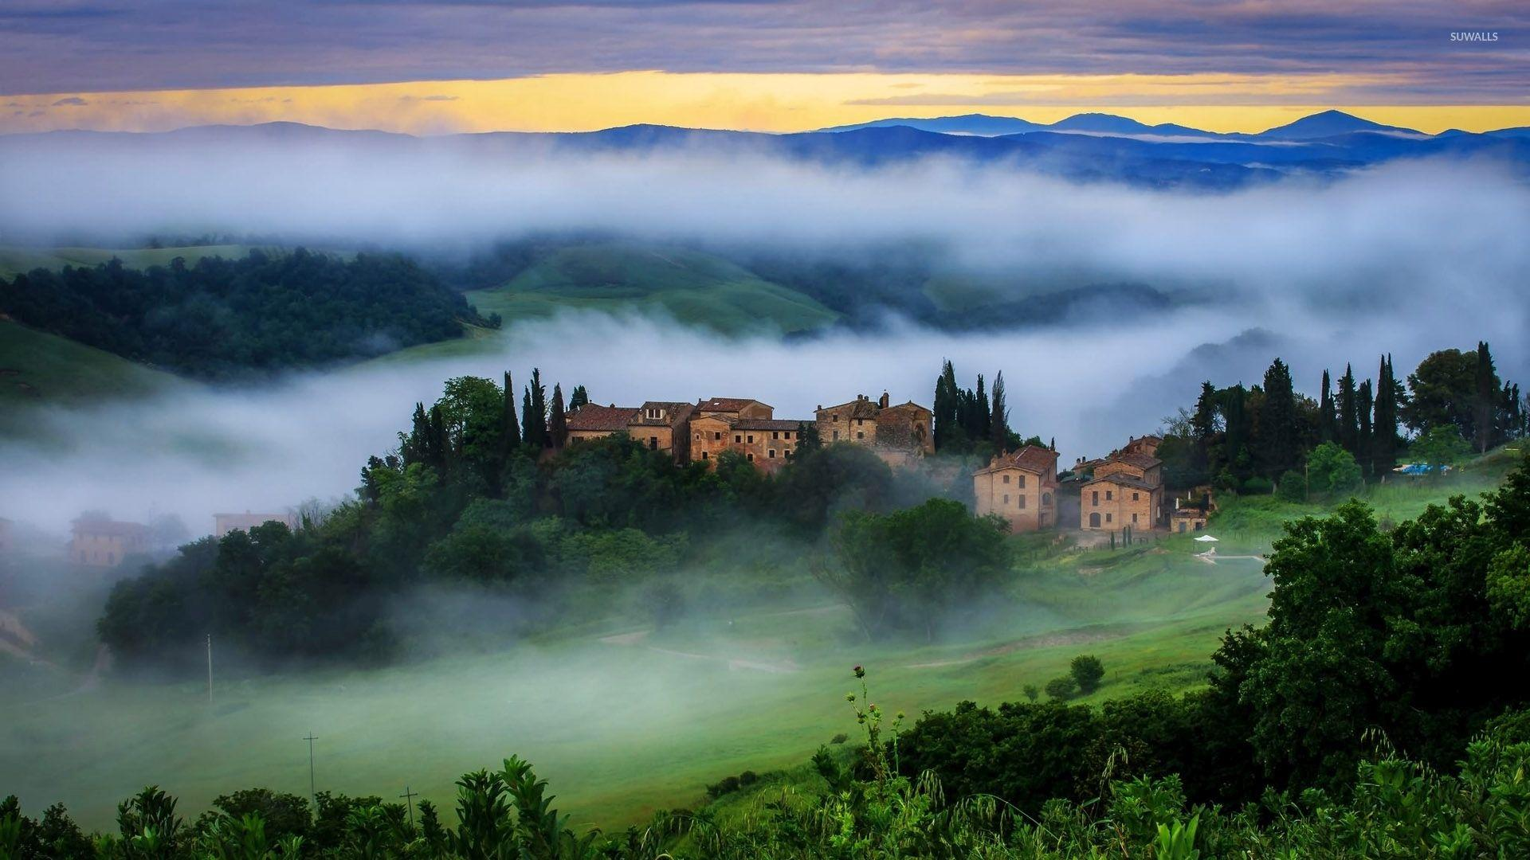
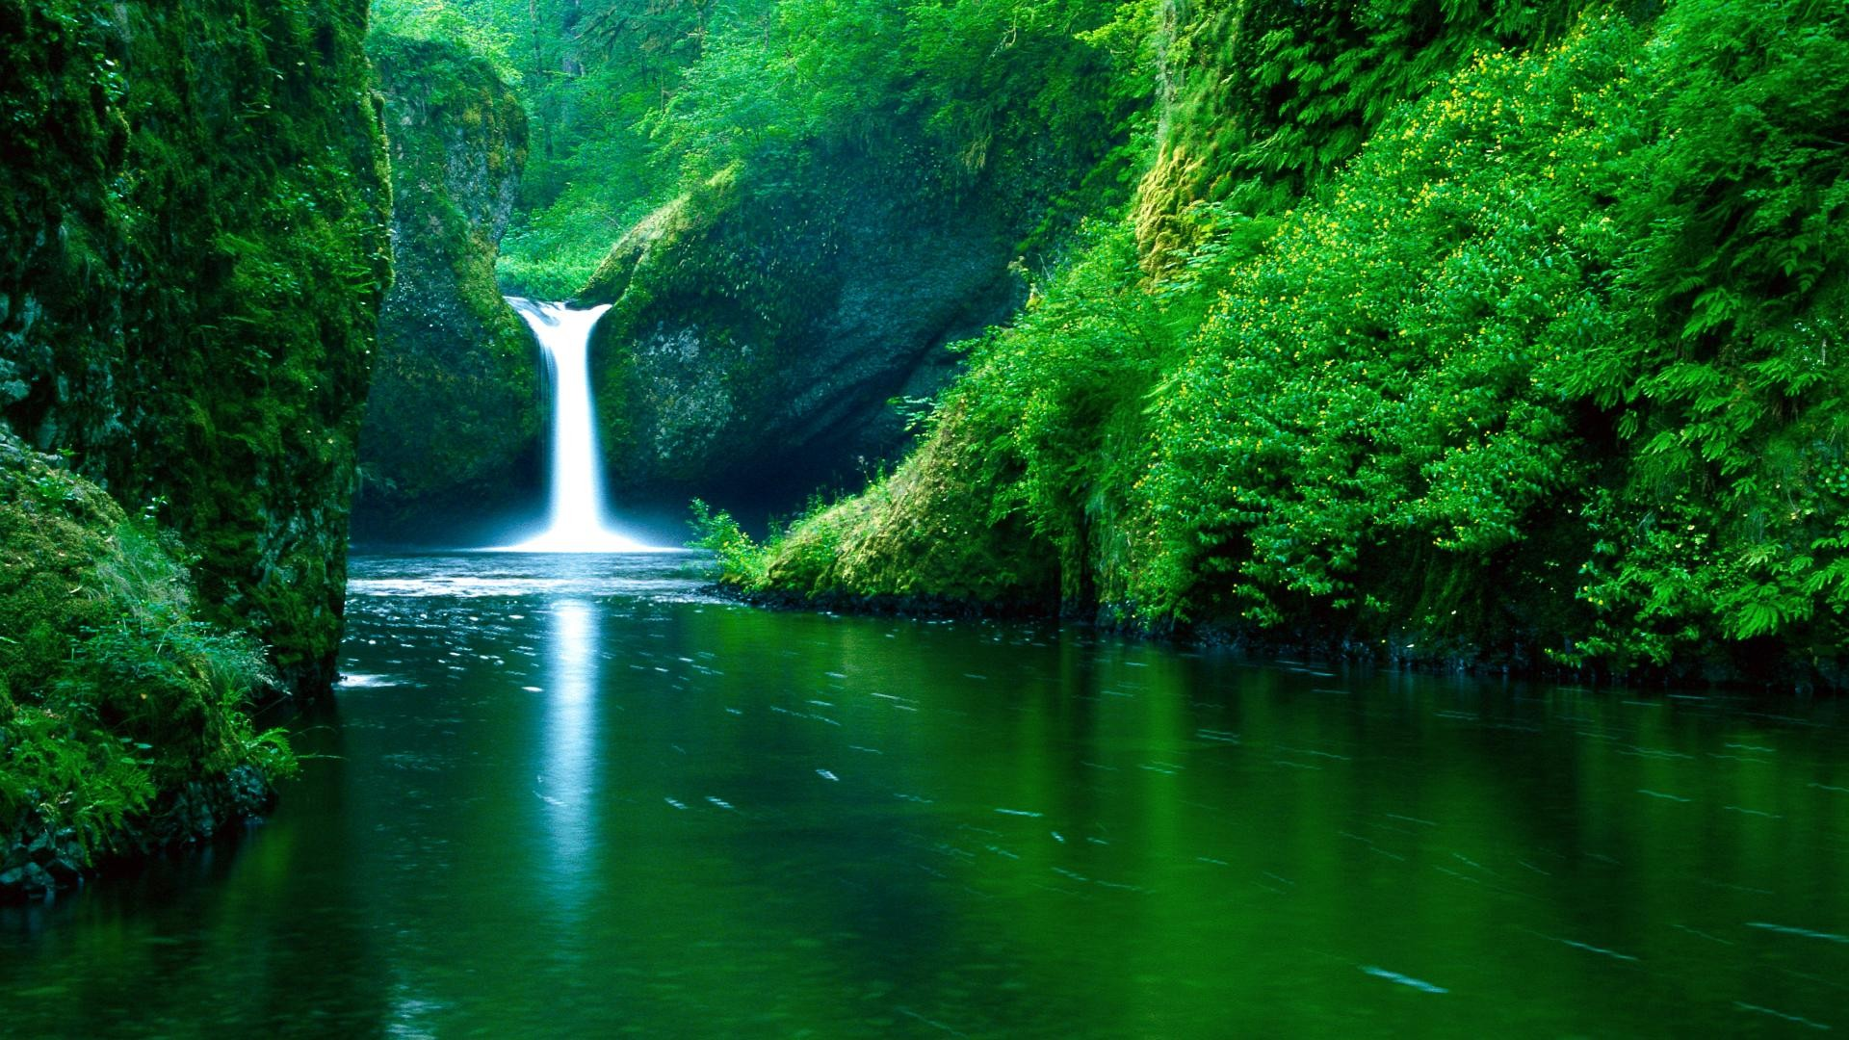
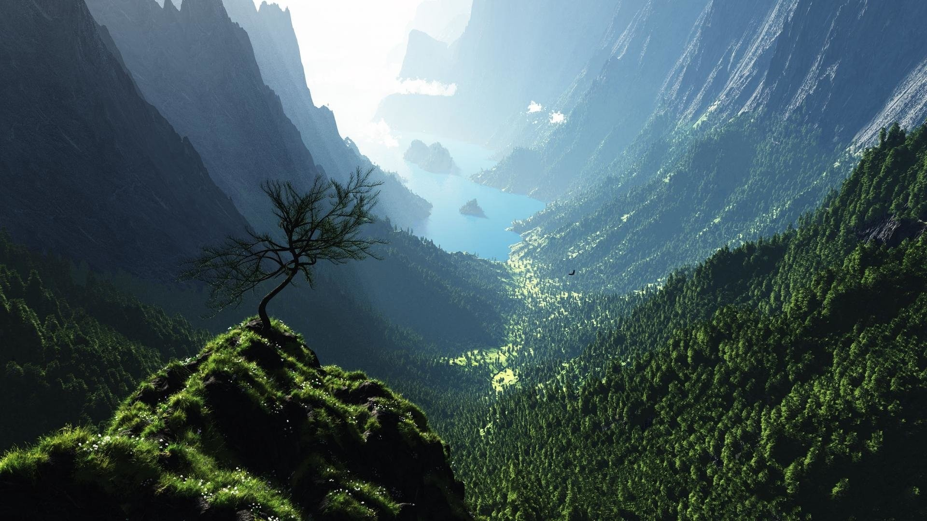
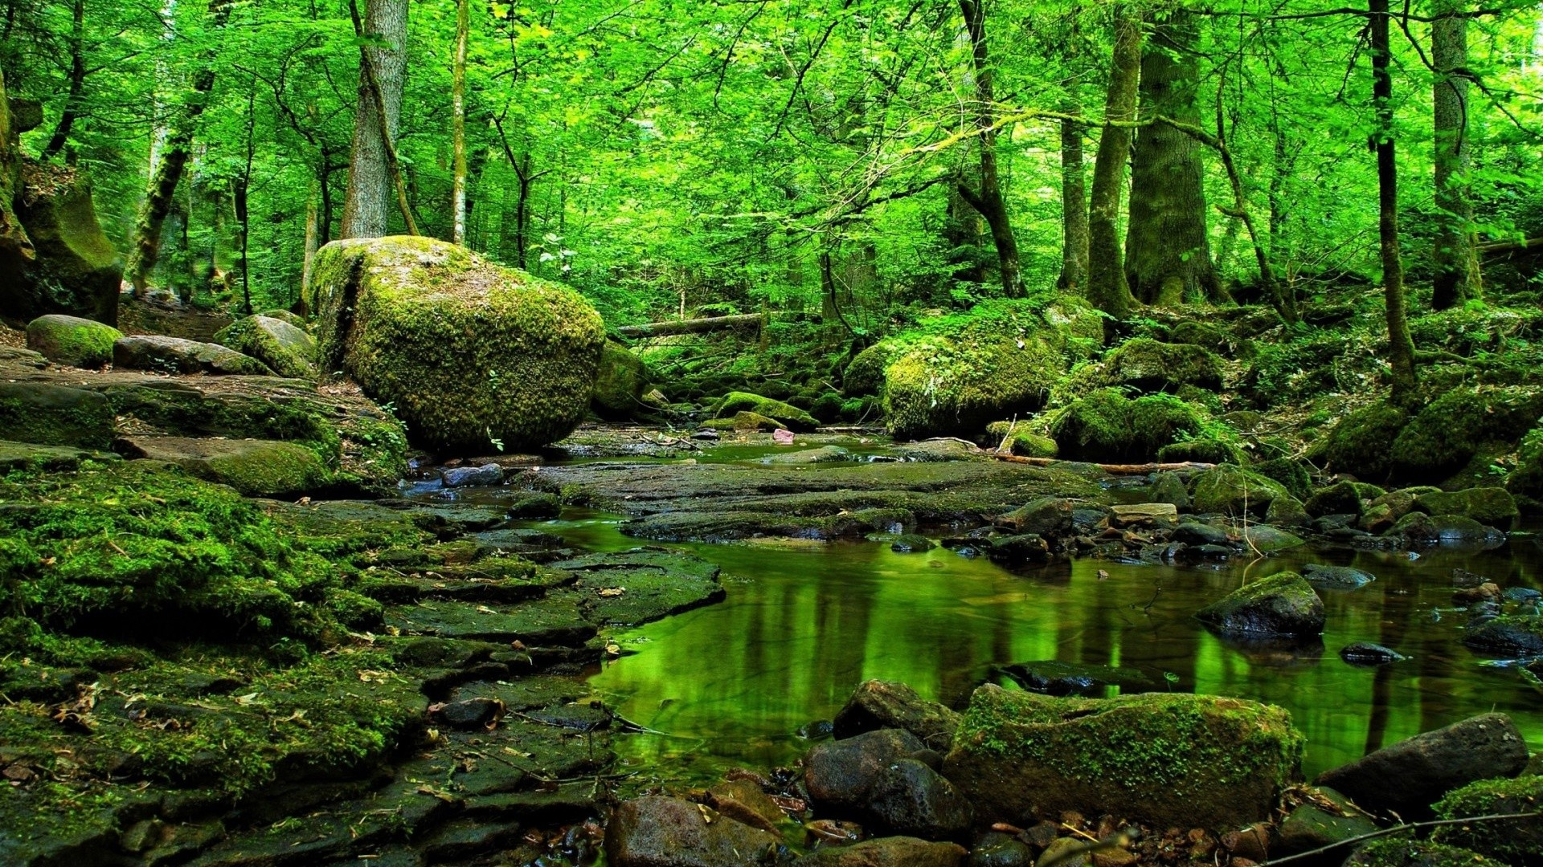
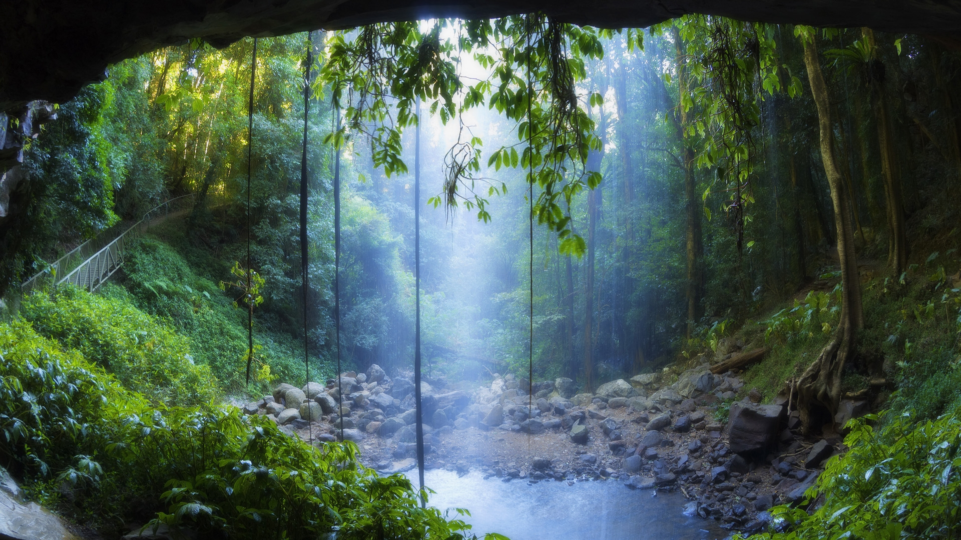
Background
Gradients
Images
ENG
09:41
13/09/20
Notes:
Light eng img001 – img001

Slide 25
Background
Gradients
Images
ENG
09:41
13/09/20
Notes:
Light eng img001 – img002

Slide 26
Background
Gradients
Images
ENG
09:41
13/09/20
Notes:
Light eng img001 – img003

Slide 27
Background
Gradients
Images
ENG
09:41
13/09/20
Notes:
Light eng img001 – img004

Slide 28
Background
Gradients
Images
ENG
09:41
13/09/20
Notes:
Light eng img001 – img005

Slide 29
Background
Gradients
Images
ENG
09:41
13/09/20
Notes:
Light eng img001 – gra001

Slide 30
ENG
09:41
13/09/20
Notes:
Light eng img001

